Slide 1
MERC Alternative School
Title I State of the School Presentation

Slide 2
What is Title I?
Title I is a federal program that provides financial assistance to schools serving low-income students.
Its goal is to help all students meet academic standards and provide educational equity.
Title I funds support various initiatives like extra tutoring, educational resources, and family engagement activities.
Schools are identified as Title I based on the percentage of students from low-income families.

Slide 3
Who Qualifies for Title I?
Schools with a high percentage of students from low-income families (based on Free and Reduced Lunch data) can qualify.
Title I services are aimed at students who are at risk of academic failure or are struggling to meet state academic standards.
At MERC, Title I status allows us to support students with additional resources.

Slide 4
Title I Requirements for Schools
  Schools must develop a Schoolwide Plan to ensure that all students receive a high-quality education.
  Title I schools must provide assistance to students to help them meet academic standards.
  Teachers and staff in Title I schools must be highly qualified.
  Schools are required to track student progress and provide regular updates to parents.
  Schools must conduct annual meetings with families to explain Title I services and rights.

Slide 5
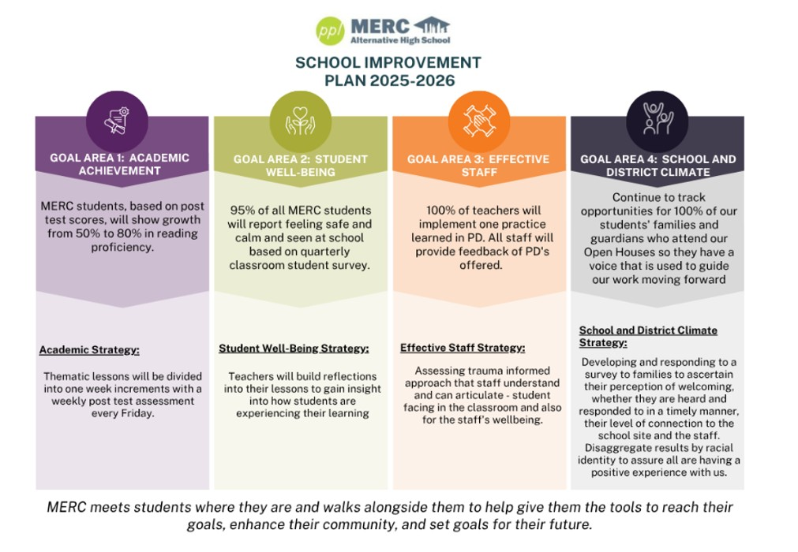

Slide 6
Benefits of Title I Status
Additional Support: Extra instructional time, tutoring, and specialized teaching methods.
Smaller Class Sizes: More individualized attention for students.
Educational Resources: Funding for technology, books, and materials.
Parent and Family Engagement: Funds are allocated for parent workshops, family involvement programs, and communication tools.
Improved Student Achievement: Focus on closing achievement gaps and providing a stronger academic foundation.

Slide 7
Family Rights and Involvement in Title I Schools
Families have the right to receive information about the school’s Title I program, including how the funds are being used.
Parents can participate in decision-making regarding the school’s educational strategies and the use of Title I funds.
Schools must provide regular communication about student progress, including report cards and assessments.
Families have the right to request qualifications of teachers and instructional staff.
Parent Involvement: Opportunities for families to be actively involved in the school’s programs (parent-teacher conferences, workshops, committees).

Slide 8
Ways Families Can Get Involved
Attend Parent-Teacher Conferences to discuss student progress and areas for improvement.
Volunteer for school events and help with classroom activities.
Participate in the Title I Parent Advisory Committee.
Stay informed by reading newsletters, attending school meetings, and reviewing academic resources.
Provide feedback through surveys or direct communication with staff.

