Slide 1
MERC Alternative High School
State of the School Meeting
3rd October 2019
Accountability,
Innovation, and
Research

Slide 2
Agenda
MERC Alternative High School: WHO WE ARE
Mission and vision
Strengths
Challenges
OUR SCHOOL IMPROVEMENT PLAN
Goals and strategies
Sharing student progress
TITLE I
Overview of Title I
How we’re using our Title I funds
Title I and Family Engagement
Notes:
1 min

Slide 3
MERC Alternative High School: Who We Are

Slide 4
Who We Are
Mission
MERC is a safe, structured environment with small class size, a committed staff, and a determination to help students make plans and set goals for their future.
Vision
MERC meets students where they are and walks alongside them to help give them the tools to reach their goals, enhance their community, and set goals for the future.
School Stats
MERC serves students from 10th – 12th grade up to the age of 21
MERC office Work Based Learning credits and assistance. MERC also has D3 partnership with MCTC so students can take college classes and get high school and college credit.
Notes:
3-5 min

Slide 5
Our School Improvement Plan

Slide 6
What’s a School Improvement Plan?
Our school improvement plan:
Sets the goals that our school community is working to achieve
Identifies the strategies or activities that will help us reach those goals together
Every Minneapolis Public School is required to develop, implement, and monitor a school improvement plan.
Notes:
2 min

Slide 7
Our School Improvement Plan
Goal:
College and Career Readiness goal: By 2020, the D3 enrollment for All Students will increase and all graduating Seniors will have a post – secondary plan.
Strategy to achieve our goal:
Presentations from MPS D3 counselor to entire MERC student body
Continuation of The Senior Class which will explore options post graduation as well as time in class for FAFSA completion and college application assistance.
Notes:
10 min total for all goal/strategy slides

Slide 8
Our School Improvement Plan
Goal:
Social-Emotional Learning goal: By 2020, absence for all students will decrease
Strategy to achieve our goal:
Frequent credit and grade checks with students so they can tangibly see the effect of regular attendance
Call and emails home to make sure parents and guardians are aware of student’s attendance as well as progress

Slide 9
Our School Improvement Plan
Goal:
School Climate goal: By 2020, the School Climate Survey factor: School Safety for all Students will increase
Strategy to achieve our goal:
Students and their families will feel a part of the MERC community and feel invested
Staff will always be open to listen to students’ concerns and worries
Students’ successes and ideas will be celebrated as an integral part of MERC’s success

Slide 10
How We Measure Student Progress
We want to make sure our students are learning as much as possible, so we use state and district assessments to determine their strengths and areas for growth. The results of these assessments help us figure out how we can better support our students in the classroom.
Assessments help us answer questions such as:
Are we teaching what we think we are teaching?
Are students learning what we intend for them to be learning?
Are all students improving and being appropriately challenged?
Some of the assessments our students will take this year are:
End of Quarter exams
Accuplacer test for those entering D3
Notes:
5 min

Slide 11
How We’ll Share Student Progress with You
Throughout the year, we’ll share information with you about how your student is doing in the classroom.
We’ll do it in the following ways:
Parent-Teacher conferences on the 3rd of October
Quarterly report cards Every 3 weeks throughout each Quarter
Notes:
3 min

Slide 12
Title I

Slide 13
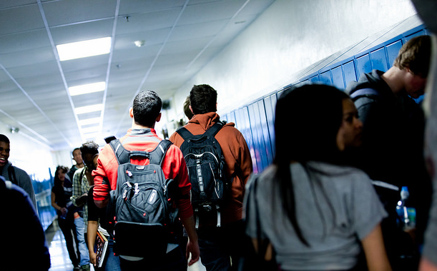
What is Title I?
Title I is a federal program that provides money to schools and districts to help them ensure all children have an equal opportunity to get a high-quality education and achieve proficiency on our state’s academic standards and assessments.
Title I supports our School Improvement Plan, and the funding we receive helps us reach our goals.
Notes:
2 min

Slide 14
MERC Alternative High School is a schoolwide Title I program, which means all our students are able to benefit from the services we provide with our Title I funding.
We are required to use Title I funding to improve the academic achievement of all students and engage YOU, our families, in that process!
Notes:
2 min

Slide 15
As a family member in a Title I School, you have the right to…
Request information from the district about whether your student’s teacher meets State licensing approval for the grade and subject being taught, is teaching with a waiver, and/or has certification for the field being taught
Request information about the qualifications of any paraprofessional providing instruction
Know how your child’s school is rated on its state test scores
Expect regular communication with your school in a language that you can understand
Work with other families and staff to develop a compact between our school and our families
Help plan how money for family involvement should be spent
Work with teachers, other families, and the school principal to develop a family involvement plan
Ask for a meeting with your school principal or your child’s teacher at any time
Notes:
5 min

Slide 16
Opportunities for Families to be Involved!
We want your input on our:
School Improvement Plan goals and strategies
Family Involvement Plan
School-Family Compact
You can find all these documents on our school website!
We’d love to see you at the following school events:
Parent-Teacher Conferences on: 3rd October 2020
Participate in Site Council!
Visit your child’s classroom or volunteer at our school!
Talk to your child’s teacher about events and issues that may affect your child’s work or behavior.

Slide 17
School Staff Information
Lead Teacher
Sheri Langevin 612.872.2777
sheri.langevin@ppl-inc.org
Family Liaison
Moses Hungiapuko 612.871.2777 moses.hungiapuko@ppl-inc.org
Notes:
1 min

Slide 18
We appreciate you!

